Slide 1
Applications of Neural Networks with Long Short-Term Memory (LSTM)
Guidance- by- Prof. Dr. Jörg Schäfer 1. shaikh safir Mohammad (1322554) Ms. Fatima butt 2. Yelpale Kshitij (1322509)

Slide 2
Introduction
Recurrent neural network(RNN) which also called as feedback neural network in which neurons in layer j get feed forward input and receives input from neurons in higher (following) layers, usually next layer j+1 (backward), but also from neurons of same layer j.

Slide 3
Activation function – Sigmoid

Slide 4
Activation function – Hyperbolic Tangent

Slide 5
Activation function – Rectified Linear Unit

Slide 6
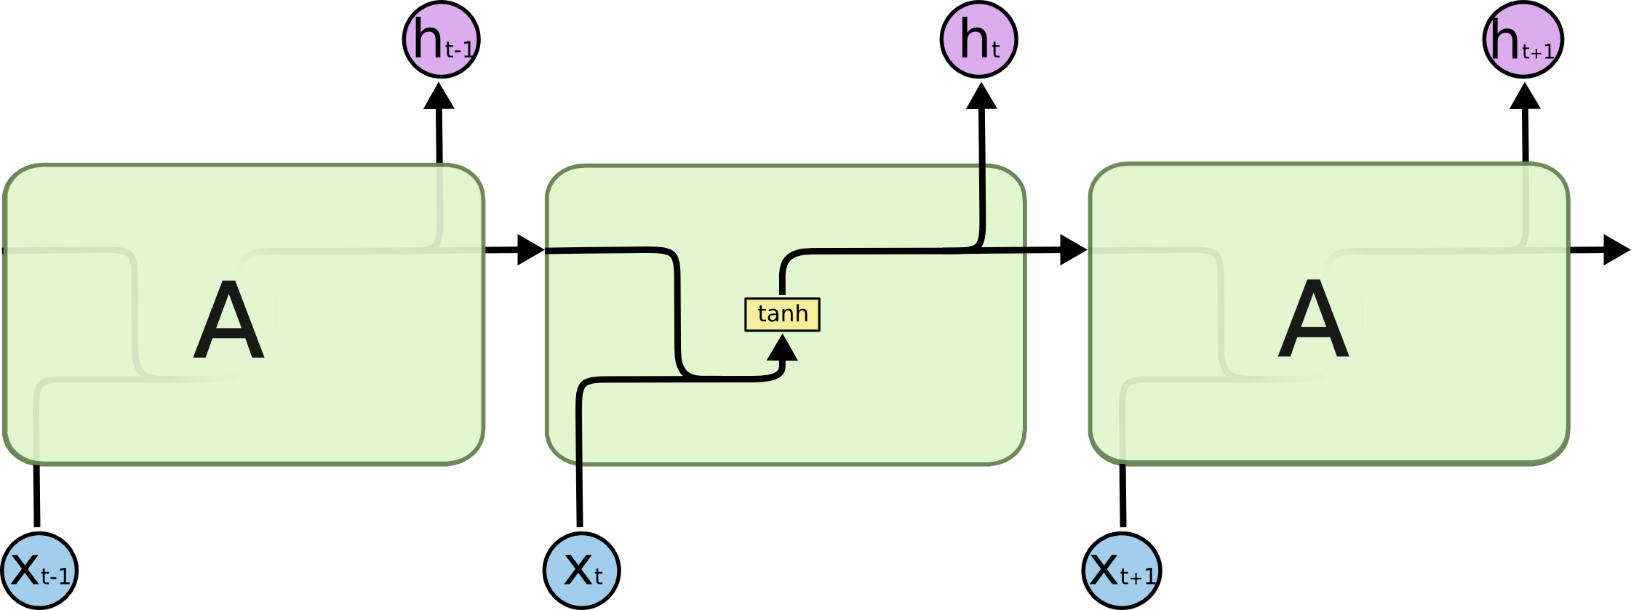
Structure of RNN

Slide 7
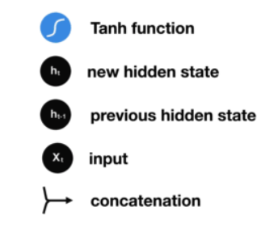
Structure of RNN
Notes:
Phi, M., Medium. 2018. Illustrated Guide to LSTM’s and GRU’s: A step by step explanation. [Blog] Available at: <https://towardsdatascience.com/illustrated-guide-to-lstms-and-gru-s-a-step-by-step-explanation-44e9eb85bf21> [Accessed 11 September 2020].

Slide 8
Gradient Problem in RNNs
There are 2 major gradient problems in standard RNN structure. Gradient means taking derivative of loss measured in the layer propagate backward. Backpropagation through time (BPTT) is a famous term used in sequence models in RNN architectures.
Vanishing gradient
Exploding gradient
At the end in both the cases learning algorithm can not reach at global minima.

Slide 9
Vanishing Gradient
Gradient get minimal from last layer to initial layer, so that no effect on the learning of initial layers.
New weight = old weight – learning rate * gradient
10.999 = 10.1 – 0.001
In case of sigmoid activation function there are high chances of this problem. So tanh is preferred one
Notes:
Phi, M., Medium. 2018. Illustrated Guide to LSTM’s and GRU’s: A step by step explanation. [Blog] Available at: <https://towardsdatascience.com/illustrated-guide-to-lstms-and-gru-s-a-step-by-step-explanation-44e9eb85bf21> [Accessed 11 September 2020].

Slide 10
Exploding gradient
Here gradient becomes very large so that it breaks all the weights in network.
In case of ReLU function, gradient can be > 1 and on every successive layer it becomes so large

Slide 11
Solutions on gradient problems
Exploding gradient
Truncated Backpropagation
Penalties
Gradient Clipping
Vanishing gradient
Weight Initialization
Echo State Networks
Long Short-Term Memory Networks (LSTMs)

Slide 12
LSTMs mimic Human Memory
Notes:
Phi, M., Medium. 2018. Illustrated Guide to LSTM’s and GRU’s: A step by step explanation. [Blog] Available at: <https://towardsdatascience.com/illustrated-guide-to-lstms-and-gru-s-a-step-by-step-explanation-44e9eb85bf21> [Accessed 11 September 2020].

Slide 13

LSTM Architecture
Notes:
Colah, 2015. Understanding LSTM Networks. [Blog] Colah's Blog, Available at: <http://colah.github.io/posts/2015-08-Understanding-LSTMs/> [Accessed 11 September 2020].

Slide 14
Forget Gate
Notes:
Phi, M., Medium. 2018. Illustrated Guide to LSTM’s and GRU’s: A step by step explanation. [Blog] Available at: <https://towardsdatascience.com/illustrated-guide-to-lstms-and-gru-s-a-step-by-step-explanation-44e9eb85bf21> [Accessed 11 September 2020].

Slide 15
Input Gate
Notes:
Phi, M., Medium. 2018. Illustrated Guide to LSTM’s and GRU’s: A step by step explanation. [Blog] Available at: <https://towardsdatascience.com/illustrated-guide-to-lstms-and-gru-s-a-step-by-step-explanation-44e9eb85bf21> [Accessed 11 September 2020].

Slide 16
Cell State
Notes:
Phi, M., Medium. 2018. Illustrated Guide to LSTM’s and GRU’s: A step by step explanation. [Blog] Available at: <https://towardsdatascience.com/illustrated-guide-to-lstms-and-gru-s-a-step-by-step-explanation-44e9eb85bf21> [Accessed 11 September 2020].

Slide 17
Output Gate
Notes:
Phi, M., Medium. 2018. Illustrated Guide to LSTM’s and GRU’s: A step by step explanation. [Blog] Available at: <https://towardsdatascience.com/illustrated-guide-to-lstms-and-gru-s-a-step-by-step-explanation-44e9eb85bf21> [Accessed 11 September 2020].

Slide 18

Backpropagation in LSTMs

Slide 19
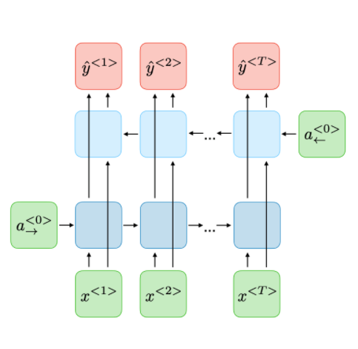
Other variants – Bi directional RNN/LSTM

Slide 20
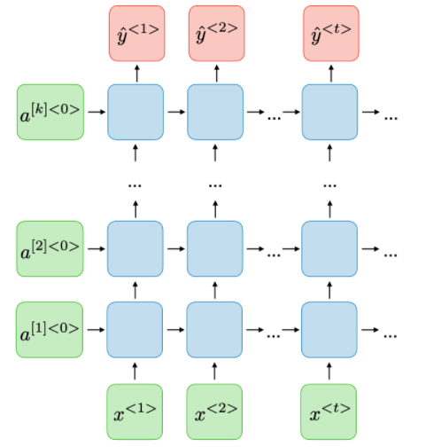
Other variants – Deep RNN/LSTM

Slide 21
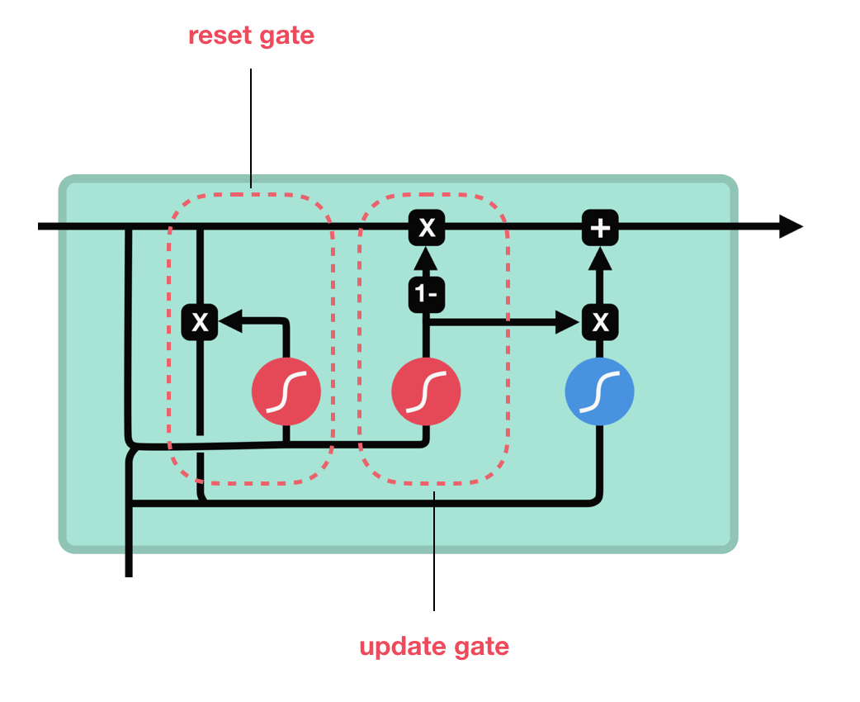
Other variants – Gated Recurrent Unit(GRU)

Slide 22
Application – Sentiment Analysis
Sentiment Analysis is -
the term which is used very often in web-based business sites, social networks and different fields.
an examination field to analyze people’s subjective sentiments.
More Advanced, Focus on “Beyond Polarity”

Slide 23
Implementation
Dataset: IMDB Movie Reviews [1]
Data Pre-processing
Library: Keras
Word Embedding: One-Hot representation + Keras encoded Imdb format
Model: (Embedding + Bidirectional(LSTM( )) + Bidirectional(LSTM( )) + Dense)

Slide 24
Performance Measures
 | # Epochs | Training Accuracy | Validation Accuracy
LSTM (Trained on Custom IMDB Dataset with One-Hot Encoding) | 15 | 99.85 % | 81.29 %
LSTM (Trained on Keras’ IMDB Dataset) | 3 | 85.42 % | 82.81 %
Bi-LSTM (Trained on Keras’ IMDB Dataset) | 2 | 89.98 % | 86.89 %

Slide 25
Demo

Slide 26
Problems / Challenges
Context
Irony
Sarcasm
Emojis (:D, ¯ \ _ (ツ) _ / ¯ etc.)
Definition of Neutral
Overfitting
Large difference between training and validation accuracy
Keras’ feature updates!

Slide 27
Results - Correlation
Performed correlation test –
between predicted values of LSTM and actual sentiments
on 4500 documents (sentiments)
Correlation Coefficient Test | LSTM and Actual sentiment
Pearson | 0.882
Spearman Rank | 0.886

Slide 28
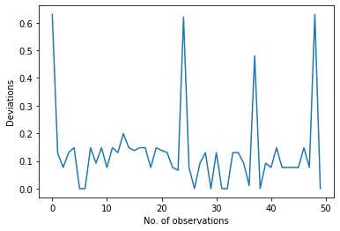
Results – Characteristic Values
Deviations | LSTM and User sentiment
Mean | 0.133
Standard Deviation | 0.147

Slide 29
Other applications
Speech recognition
Speech synthesis
Text generation
Video captioning
Time series analysis
Name entity recognition
Video activity recognition
Image captioning
Machine translation
Music generation

Slide 30
References
[1] Andrew L. Maas, Raymond E. Daly, Peter T. Pham, Dan Huang, Andrew Y. Ng, and Christopher Potts. (2011). Learning Word Vectors for Sentiment Analysis. The 49th Annual Meeting of the Association for Computational Linguistics (ACL 2011).

Slide 31
Thank you!

